Slide 1
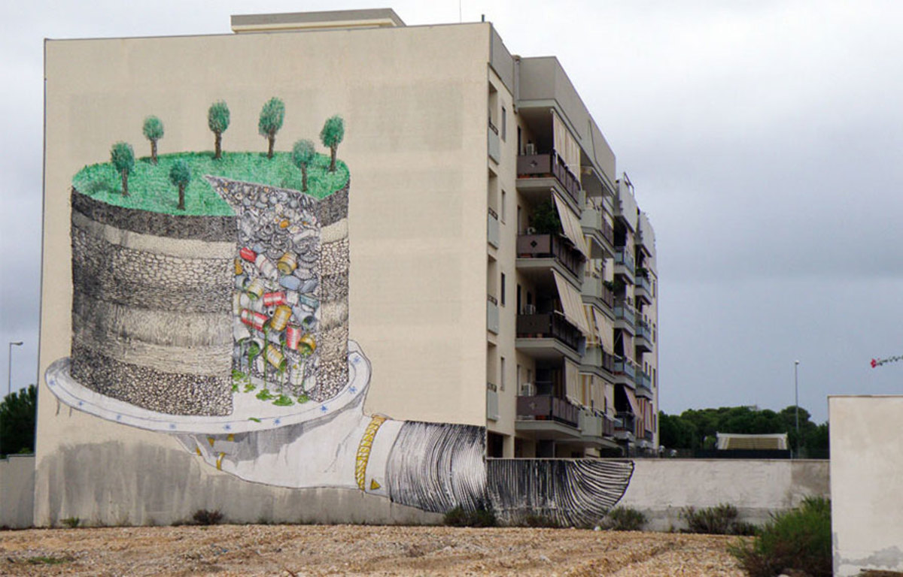
Urban cities and climate action

Slide 2
"Even as we witness devastating climate impacts causing havoc across the world, we are still not doing enough, nor moving fast enough, to prevent irreversible and catastrophic climate disruption,"United Nations Secretary-General Antonio Guterres.

Slide 3
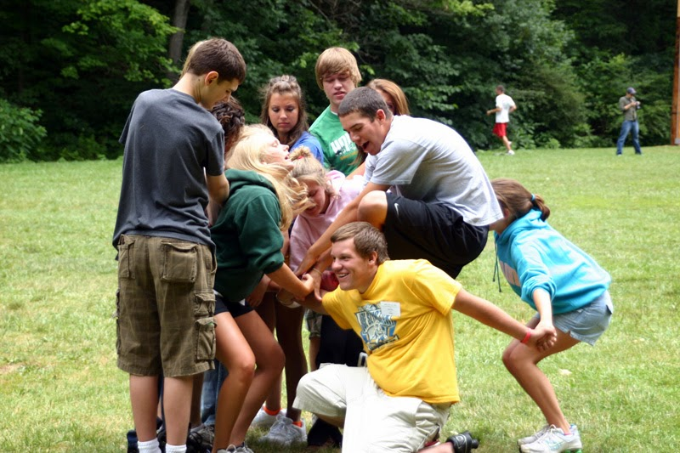
Working Together is Hard

Slide 4
The Central Idea
As the population and the energy demands of urban cities increase with time, we see them become substantial centres of emissions. Climate action is hampered by the complacency of cities over their climate responsibility. The oft-repeated rhetoric is that each region is doing more than it’s part in taking climate action given its unique concerns of juggling growth.
Using a k-means cluster analysis, we provide a way for different cities to compare themselves. Additionally, this could provide an avenue for cities to reach out to the leading members of their peer groups, for knowledge sharing.

Slide 5
K-means Clustering was used to cluster 91 global cities in to clusters based on their GDP per capita, total population and population density.
GDP per Capita
GDP per Capita
Climate Action Ability
Climate Action
Total Population
Total Population
Population Density
Population Density
These were taken as the metrics of climate action ability
Notes:
We classify cities globally using their ability to take positive climate action.
We create clusters using the GDP per capita, Population density and Total Population of the cities--which are our chosen m

Slide 6
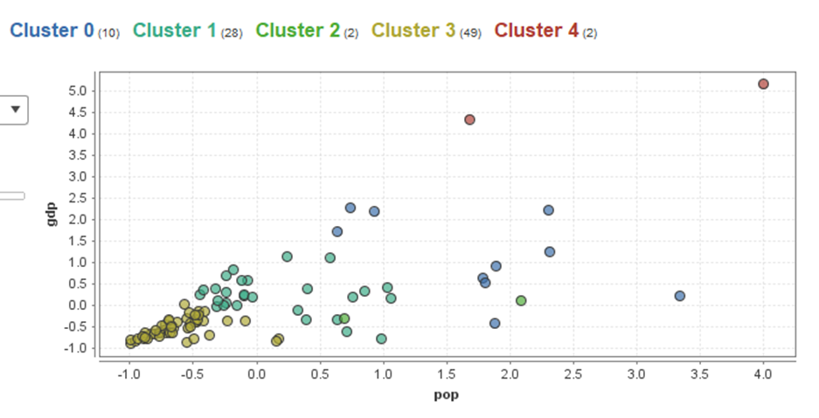

Slide 7
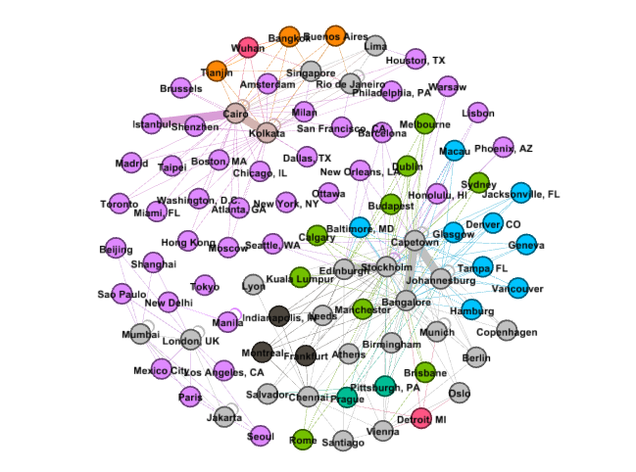

Slide 8
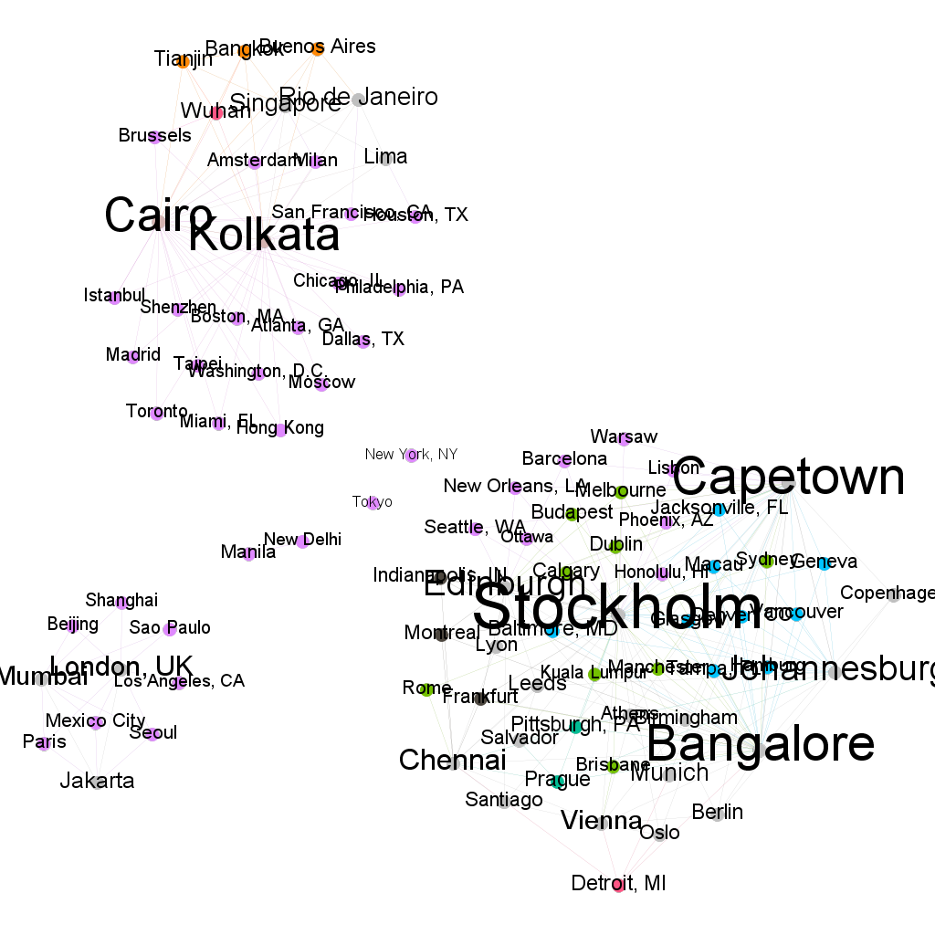

Slide 9
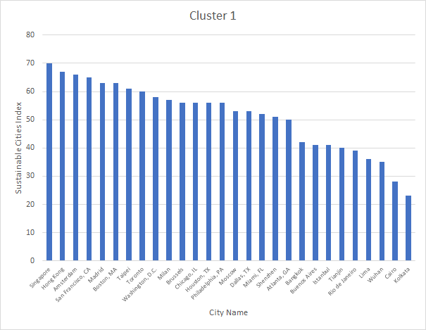
Cities (within clusters) and the Sustainable Cities Index
A metric for comparison among peer cities
Notes:
Sustainable Cities Index
Ranks on three pillars of sustainability: People, Planet, and Profit
Three pillars closely aligned to the UN Sustainable Development Goals (SDGs) and track progress against UN SDG commitments.
from Arcadis, Design & Consulting for natural and built assets

Slide 10
Future Possibilities
More cities
Closer peers
Increased Action
Notes:
Sustainable Cities Index
Ranks on three pillars of sustainability: People, Planet, and Profit
Three pillars closely aligned to the UN Sustainable Development Goals (SDGs) and track progress against UN SDG commitments.
from Arcadis, Design & Consulting for natural and built assets

Slide 11
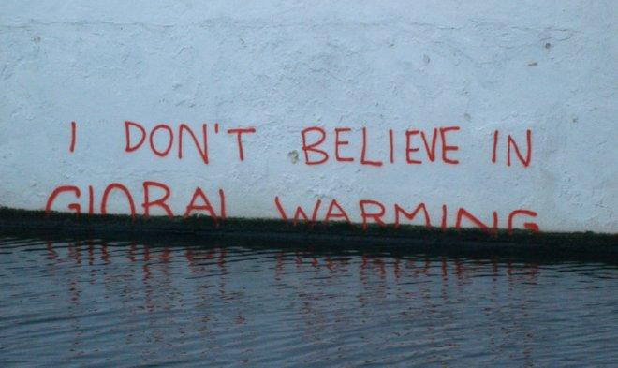
Thank You

